Slide 1


ABC Call Volume Trend Analysis
Click Here for Excel File
By, Shngain Kupar Shullai

Slide 2

Project Description
In this project, I analyzed the inbound call data of ABC Insurance Company to enhance their Customer Experience (CX) analytics.
The dataset includes comprehensive call details over 23 days, focusing on call duration, Time Bucket, call status, etc.…
My primary objectives were to determine the average call duration per time bucket, visualize call volumes over time, and devise a manpower plan to reduce call abandonment rates to 10% during both day and night shifts.
By leveraging this analysis, the goal is to optimize agent allocation and improve overall customer satisfaction.
The project also accounts for agent working hours and unplanned leaves to provide realistic staffing recommendations.

Slide 3

Approach
To tackle this project, I cleaned and organized the dataset to ensure accuracy.
I then used Pivot tables, Charts and descriptive statistics to calculate the average call duration for each time bucket and created visualizations to analyze call volume trends over the day.
To address manpower planning, I applied predictive analytics to estimate the required number of agents per shift, aiming to reduce call abandonment rates.
Additionally, I considered the assumption variables, agent working patterns and breaks to provide realistic staffing solutions.
Tools like Excel formulas, and mathematics were instrumental in executing these analyses effectively.

Slide 4

Tech-Stack Used
For this project, I utilized the following tech stack:
1. Microsoft Excel 2021:
They are used for initial data cleaning, preprocessing, advanced data manipulation, visualization, basic statistical analysis, and creating insightful visualizations to present call volume trends and manpower planning effectively.
2. Microsoft PowerPoint 2021:
Employed for advanced Project Presentation.
These tools collectively enabled a comprehensive analysis of the call data, from initial preprocessing to advanced visualization and reporting.

Slide 5

Data Understanding
No. of rows
117988
Columns
13

Slide 6

Cleaning
941 duplicate values were found & removed
(Wrapped_by, Ringing & Time) Columns were deleted
Time_Bucket Sub-category 9_10 replaced by 09_10

Slide 7


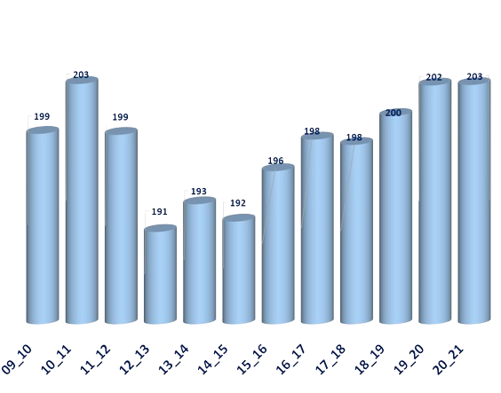
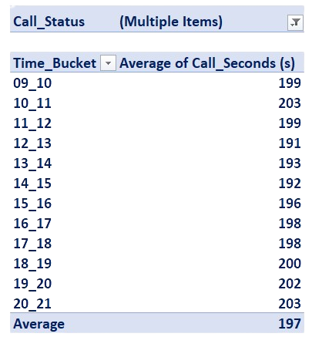

Task 1: The average duration of calls for each time bucket
Notably, the average call duration peaks during the 9 AM-12 Noon and 6-9 PM slots, indicating potentially higher engagement or more complex issues.
Conversely, the shortest average call duration occurs between 12-3 PM.
AverageCallSeconds per
TimeBucket
Despite these variations, the overall average call duration remains consistent at around 197 seconds.
These insights suggest that while call durations are relatively stable, certain periods may require more focused agent support to handle longer interactions effectively.

Slide 8



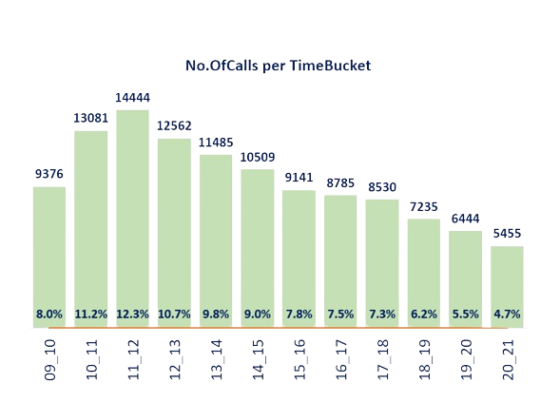
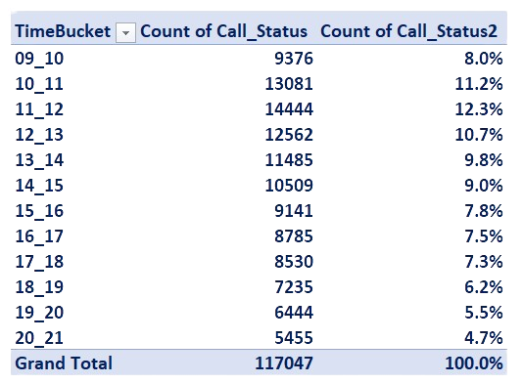
Task 2: A chart and a table that shows the number of calls received in each time bucket
The highest volume of calls occurs between 11 AM and 12 PM, accounting for 12.3% of the total calls, indicating this is a peak time for customer inquiries.
The call volume gradually decreases afternoon, with another notable drop after 5 PM, suggesting fewer customers are calling during late afternoon and evening hours.
The lowest call volume is observed between 8 PM and 9 PM, representing only 4.7% of the calls.
These patterns can inform staffing decisions to ensure adequate agent availability during peak hours and improve customer service efficiency.

Slide 9

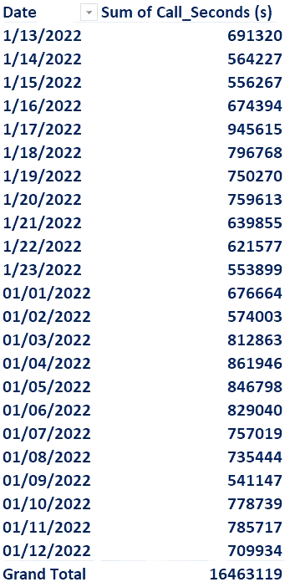
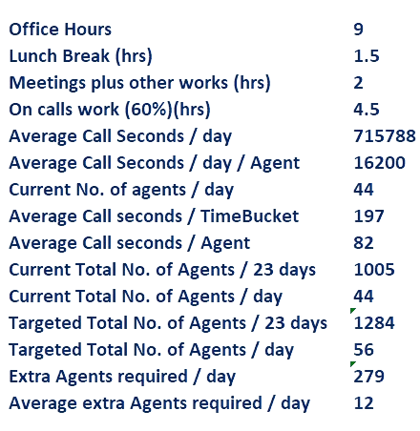
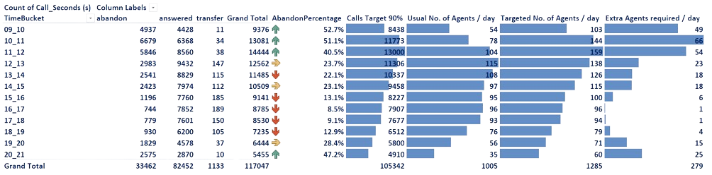
Task 3: The minimum number of agents required in each time bucket to reduce the abandon rate to 10%
Steps
Average Call Seconds / day = Grand Total 16463119 / 23 days
= 715788
Average Call Seconds / day / Agent = On calls work 4.5 hrs * 3600 seconds
= 16200 seconds
Current No. of agents / day = 715788 / 16200 = 44
Average Call seconds / Agent = 16200 / 197 = 82
Current Total No. of Agents / 23 days =SUM(AK7:AK18) = 1005
Current Total No. of Agents / day = 1005 / 23 = 44
Targeted Total No. of Agents / 23 days = SUM(AL7:AL18) = 1284
Targeted Total No. of Agents / day = 1284 / 23 = 56
Extra Agents required / day = SUM(AM7:AM18) = 279
Average extra Agents required / day = 279 /23 = 12
Assumptions

Slide 10

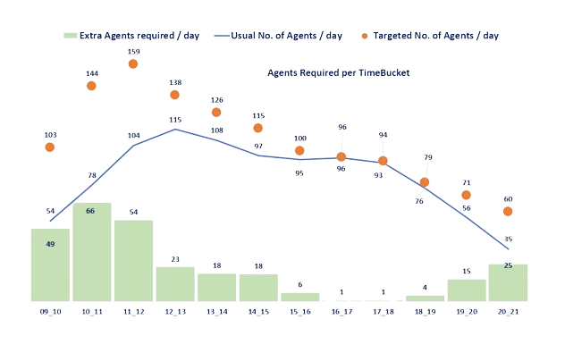
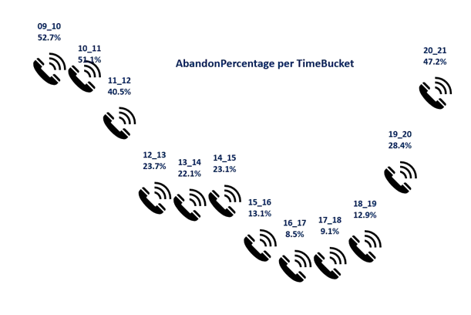
The highest call abandonment rates occur in the early morning, particularly between 09:00 and 11:00, when more than 50% of calls are abandoned.
This indicates a critical need for more agents to handle the call volume effectively during these hours.
As the day progresses, the abandonment rate decreases significantly, reaching its lowest between 16:00 and 18:00, suggesting better agent availability or lower call volumes during this period.
A notable increase in the number of agents is required to achieve the target of a 10% abandonment rate, especially in the morning and early afternoon buckets.
The data also reveals that the overall number of calls answered exceeds those abandoned, but the high abandonment rates during specific time slots highlight inefficiencies in agent allocation.
For instance, between 10:00 and 11:00, there is a need to almost double the number of agents from 78 to 144 to meet the target abandonment rate.
Similarly, significant increases are needed from 11:00 to 12:00, where an additional 54 agents are required.
The patterns suggest that agent shifts should be adjusted to start earlier and peak in the late morning hours to effectively address the high abandonment rates.
Overall, 279 agents are needed across the day to meet the target abandonment rate (10%), emphasizing the importance of strategic manpower planning to enhance customer experience.

Slide 11

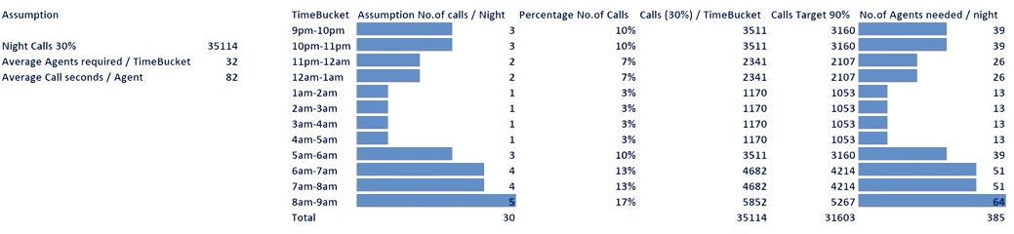
Task 4: Manpower plan for each time bucket throughout the night, keeping the maximum abandon rate at 10%
Steps
30% Night Calls = (117047)AH19*30% =35114
Average Call Seconds / Agent = AA16 = 82
Average Agents required / TimeBucket = AVERAGE(AY7:AY18) = 32

Slide 12

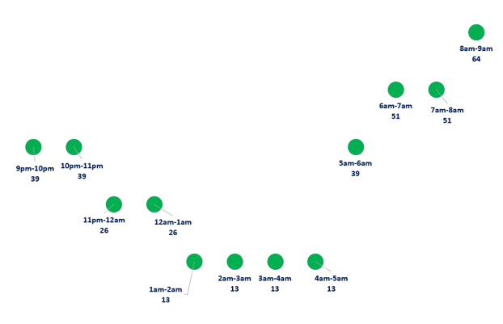

The analysis of the nighttime call data revealed significant insights into the required manpower to maintain a maximum abandonment rate of 10%.
It was found that the highest call volumes occur between 8 am and 9 am, requiring the most agents (64) to manage the influx efficiently.
The analysis showed that 39 agents are needed during the 9 pm to 11 pm and 5 am to 6 am time slots, indicating moderate call volumes.
The periods from 6 am to 8 am also exhibited a higher call volume, necessitating 51 agents per hour.
Conversely, the lowest call volumes were observed between 1 am and 5 am, with only 13 agents needed during each hour to meet the target.
Overall, the average number of agents required per time bucket throughout the night is approximately 32.
The pattern of call distribution aligns with typical business hours and early morning activity peaks.
A notable trend is the significant increase in call volume as the morning approaches, requiring a strategic increase in manpower.
These insights allow for precise scheduling and resource allocation, ensuring optimal customer service coverage throughout the night.
This detailed manpower plan ensures that customer calls are handled effectively, minimizing the abandonment rate.

Slide 13

Result
I determined the average call duration for each time bucket, finding it to be relatively consistent throughout the day with minor fluctuations
By visualizing the call volume, I identified peak periods, such as between 10 am and 12 pm, which required the most attention for resource planning
In addressing the manpower needs, I devised a plan to reduce the call abandonment rate from 30% to 10%
This involved calculating the required number of agents per time bucket, accounting for peak hours and breaks
Through this project, I conducted an in-depth analysis of ABC Insurance Company’s inbound call data, focusing on call durations, volumes, and manpower allocation
In contrast, lower call volumes between 1 am and 5 am required minimal staffing, around 13 agents per hour
This strategic allocation ensures efficient handling of calls while maintaining a low abandonment rate
For night shifts, I assessed call volumes and determined that the highest demand occurred between 8 am and 9 am, requiring up to 64 agents
The analysis revealed that an additional 12 agents per day were necessary to meet the targeted service level, particularly during high-volume periods
This comprehensive analysis provided actionable insights into managing call volumes and staffing needs effectively, ensuring a balanced approach to customer service throughout the day and night.
By analyzing detailed call data and implementing targeted staffing solutions, I contributed to the company’s efforts to enhance customer satisfaction and operational efficiency.
It emphasized the importance of precise manpower planning and resource allocation to improve customer service
Overall, the project enhanced my understanding of customer experience analytics by applying data-driven methods to optimize call center operations

